Slide 1
Twitter Analysis using R
Ramesh Ragala
Assistant Professor(Sr)
VIT Chennai Campus

Slide 2
Twitter Analysis using R
Packages
1. twitteR
2. tm
3. wordcloud
4. ROAuth, Rcurl
5. httpuv
twitteR package provides access to Twitter data.
It is intended to provide access to the Twitter API with in R
twitteR package uses httr package.
tm package provides functions for text mining
wordcloud package is used for visualizing the result with word cloud.

Slide 3
Twitter Analysis using R
Extract the data from the Twitter
Cleaning the extracted data
Build a document-term matrix
Finding Frequent words and associations
Creating a wordcloud to visualize important words

Slide 4
Twitter Analysis using R
Extract the data from the Twitter
Open the Twitter Application Management with following URL
https://apps.twitter.com

Slide 5
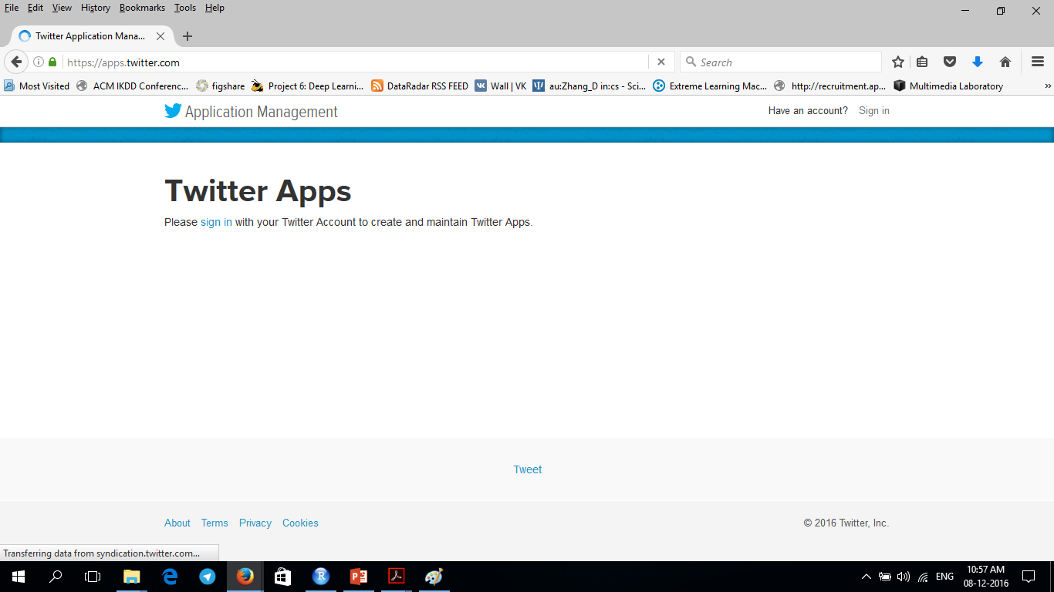
Twitter Analysis using R

Slide 6
Twitter Analysis using R
Extract the data from the Twitter
Open the Twitter Application Management
Login to Twitter Account

Slide 7
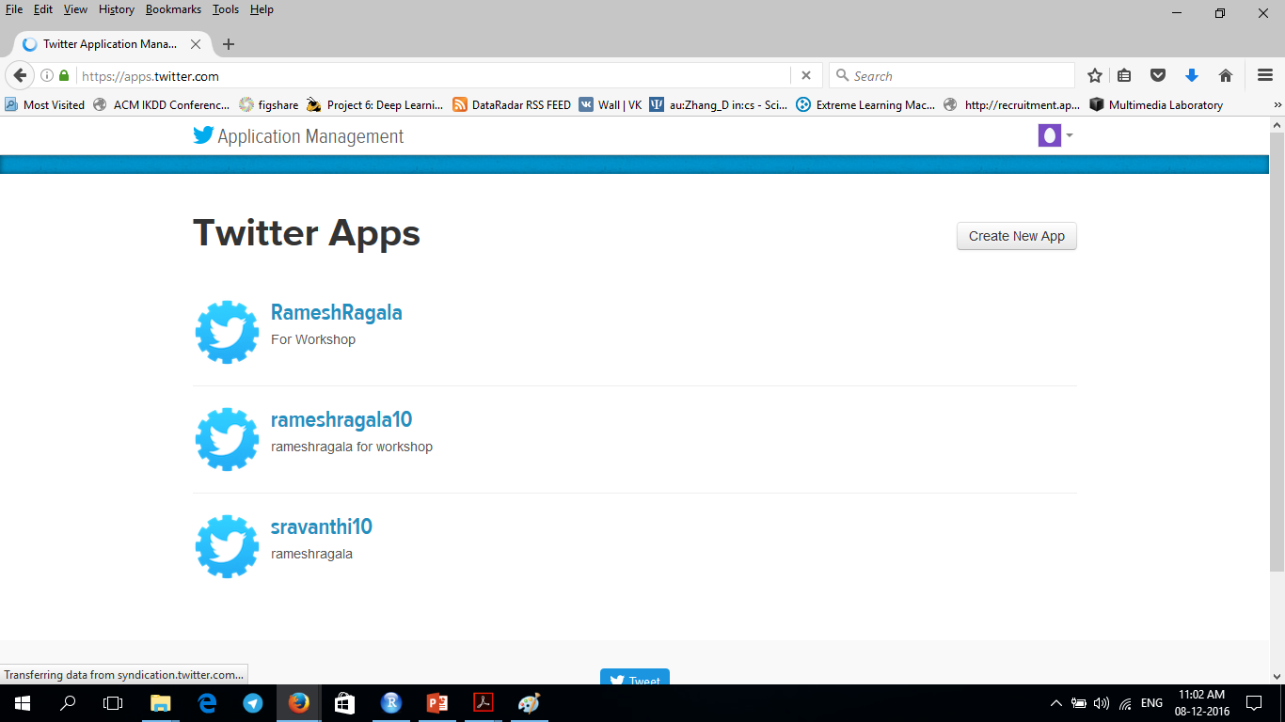
Twitter Analysis using R

Slide 8
Twitter Analysis using R
Extract the data from the Twitter
Open the Twitter Application Management
Login to Twitter Account
Click on → Create a New App

Slide 9
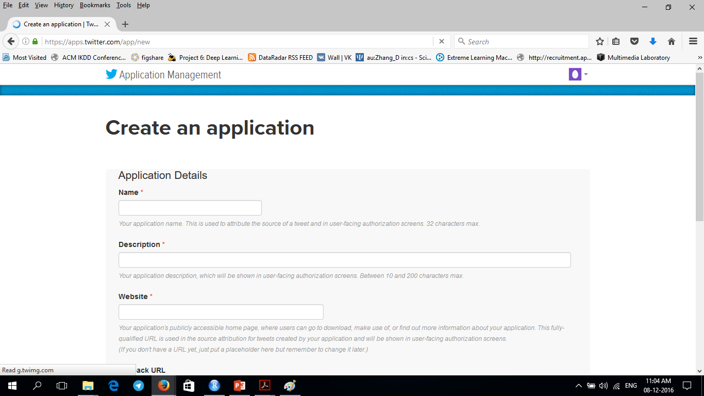
Twitter Analysis using R

Slide 10
Twitter Analysis using R
Extract the data from the Twitter
Open the Twitter Application Management
Login to Twitter Account
Click on → Create a New App
Name → your choice
Description → your choice
Website → give any URL
Callback URL → http://127.0.0.1:1410 → important for ROAuth
Check box → yes for agreement
Click on → create your twitter application

Slide 11
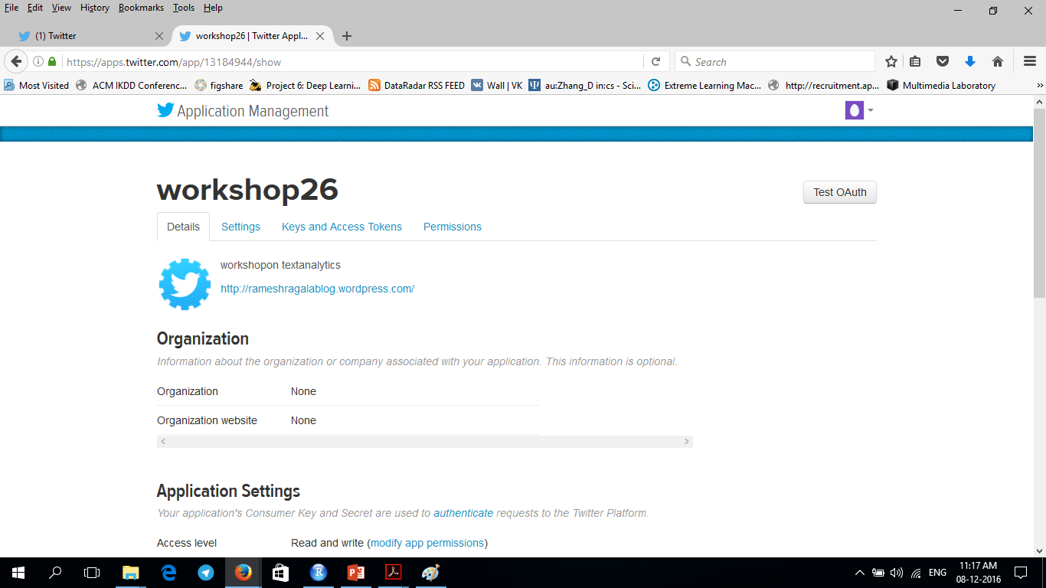
Twitter Analysis using R

Slide 12
Twitter Analysis using R
Extract the data from the Twitter
Open the Twitter Application Management
Login to Twitter Account
Click on → Create a New App
Name → your choice
Description → your choice
Website → give any URL
Callback URL → http://127.0.0.1:1410 → important for ROAuth
Check box → yes for agreement
Click on → create your twitter application
Click on → Permission tab and select the Read, Write and Access Direct messages radio button → save changes

Slide 13
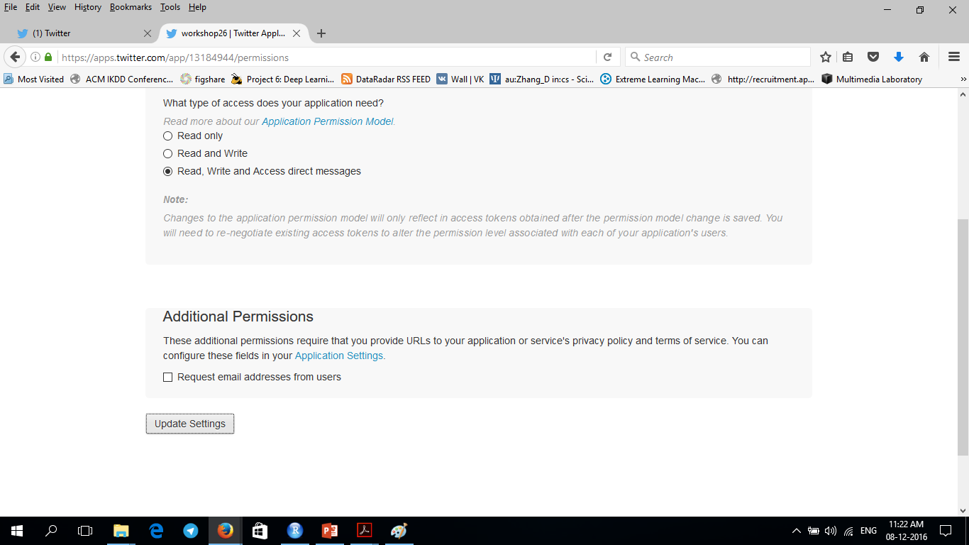
Twitter Analysis using R

Slide 14
Twitter Analysis using R
Extract the data from the Twitter
Click on → Keys and Access Token tab
We can find Consumer Key and Consumer Secret → copy into text file.

Slide 15
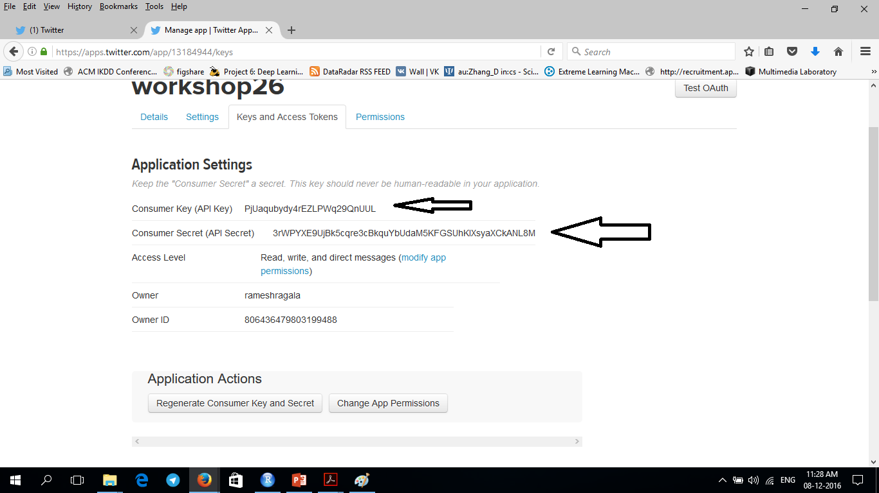
Twitter Analysis using R

Slide 16
Twitter Analysis using R
Extract the data from the Twitter
In R – session do the following
library(twitter)
library(ROAuth)
library(httr)
library(Rcurl)
setup_twitter_oauth() is used to connect Twitter
This function uses consumer API key and consumer API secret key as parameter
[1] "Using browser based authentication” → choose 1
It directly open another web page for authentication. → click on Authorize app button.

Slide 17
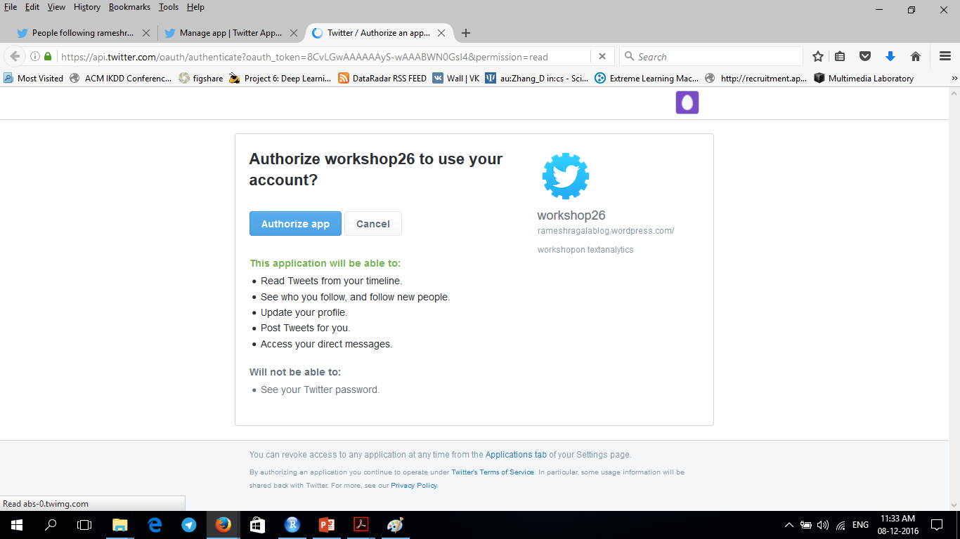
Twitter Analysis using R

Slide 18
Twitter Analysis using R
Extract the data from the Twitter
In R – session do the following
searchTwitter() is used to search for tweets that match a desired term.
tweets <- searchTwitter('#USelections',n=50) where n is number of tweets
It will returns the tweets which contains USelections.
head(tweets) → check the output
strip_retweets() is used to take list of status objects and by default will remove the official API-based retweets from Twitter.
Cases → the retweet button was pressed instead of manual
strip_retweets() is used to tell you, exactly what it describes.
head(strip_retweets(tweets,strip_manual=TRUE,strip_mt=TRUE))

Slide 19
Twitter Analysis using R
Extract the data from the Twitter
In R – session do the following
getUser() is used to gives closer look at Twitter user
ram <- getUser('rameshragala')
This will works iif the user profile is public or if you’re authenticated and granted access.
It will returns a user object, which can be used get some other information.
getFollowersCount() is used to get the followers count
ram$getFollowersCount()
ram$getDescription()
ram$getFavorites()
ram$getFriends(n=3)

Slide 20
Twitter Analysis using R
Extract the data from the Twitter
In R – session do the following
Object lists need to be convert into data.frame structure.
twListToDF() is used for converting object list into data.frame
df <- twListToDF(tweets)
head(df)
Timelines:
A Twitter timeline is simply a stream of tweets.
Two types: user timeline and home timelines
usertimeline → provides the most recent tweets of a specified user
hometimeline → used to display your own most recent tweets

Slide 21
Twitter Analysis using R
Now we can perform some analytics using tm package on tweets data.

